Slide 1
Price Prediction for Mobile Phones

Slide 2
Introduction
Your primary goal is to develop a predictive model for mobile phone prices. The objective is to build a predictive model that can accurately estimate the price of a mobile phone based on its features. To achieve this, you'll perform a feature extraction analysis to identify the most influential features.

Slide 3
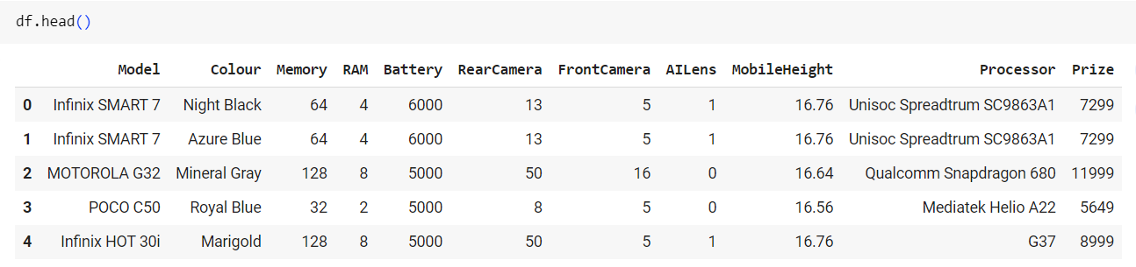

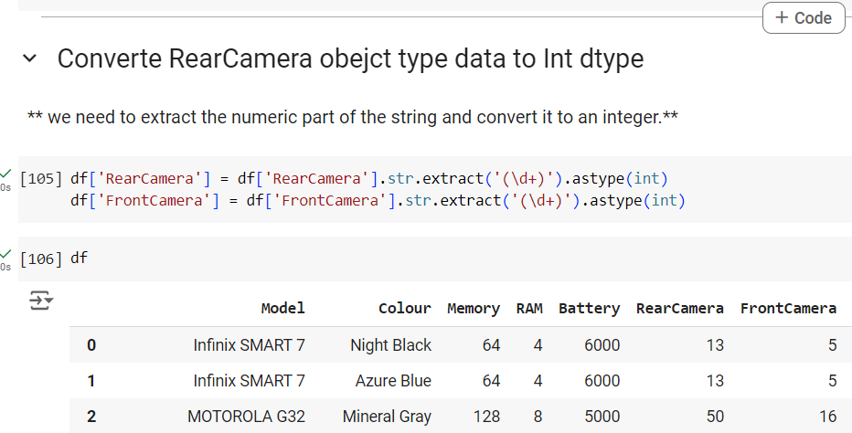
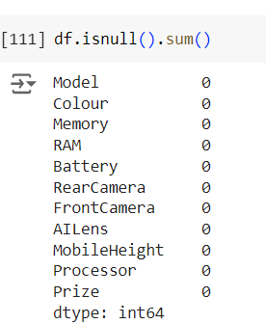
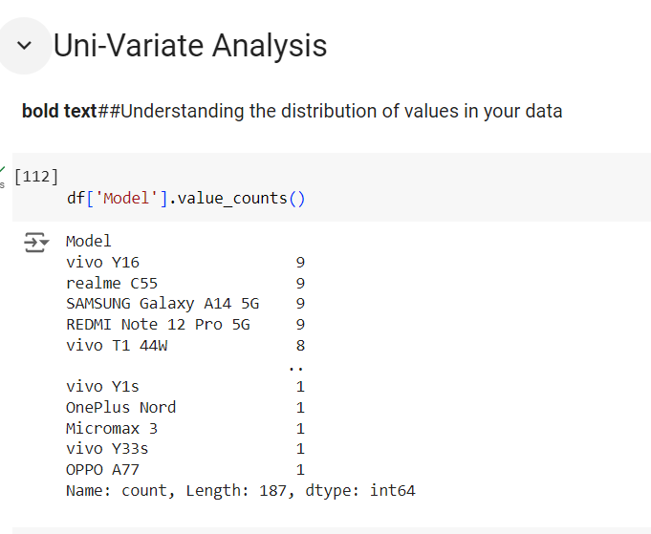
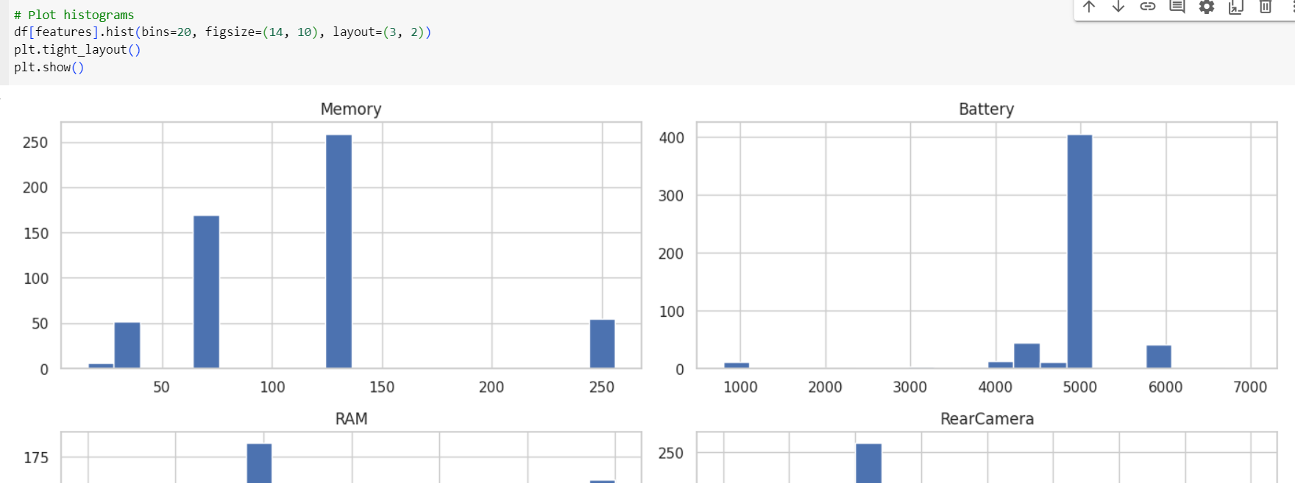
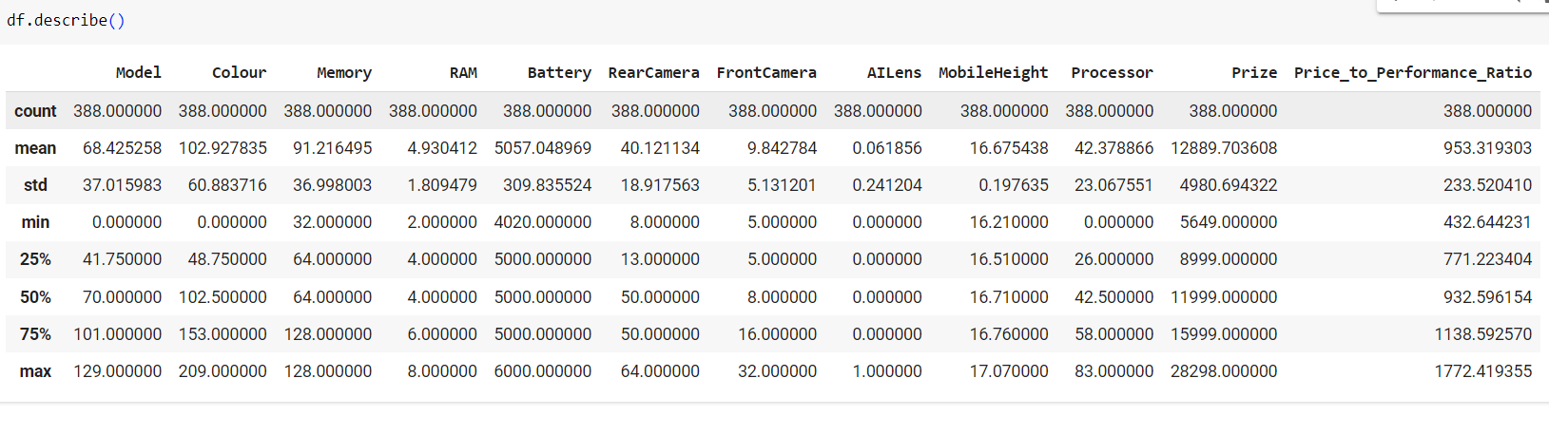
Data Exploration:
Understanding Data Structure:
Summary Statistics:
Missing Values
Data Visualization:
Correlation Analysis:
Identifying Outliers:
Data Cleaning:
Transformations:

Slide 4

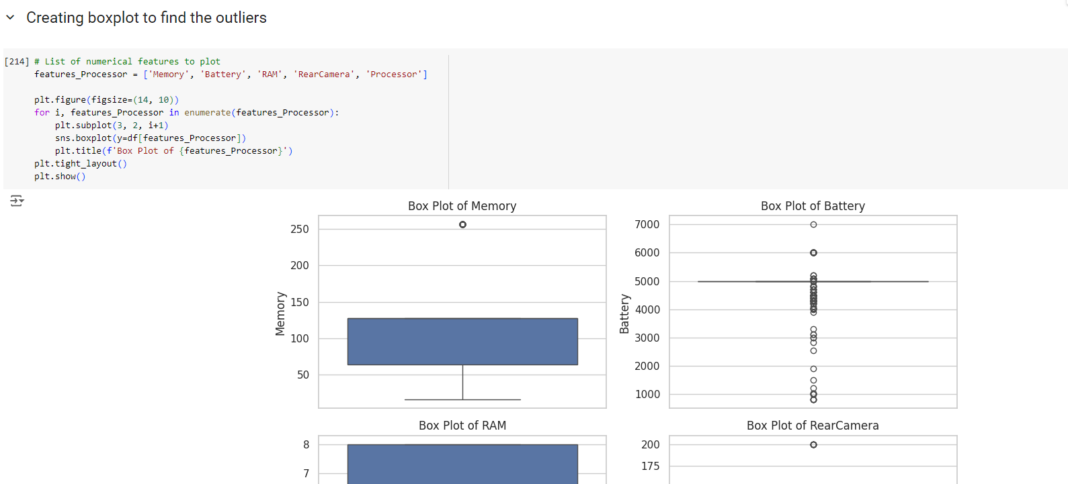
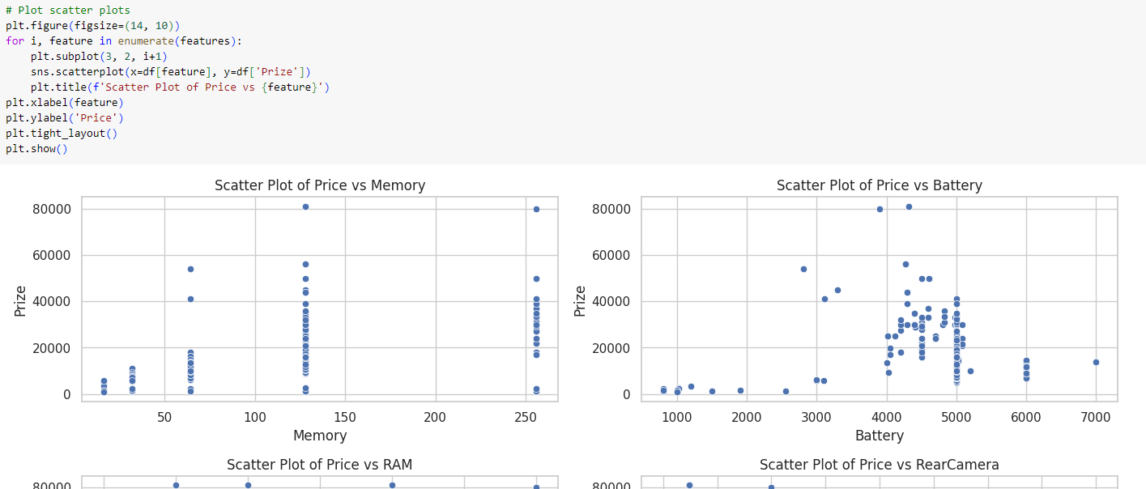
Uni-Variate Analysis bivariate scatter plot ​

Slide 5
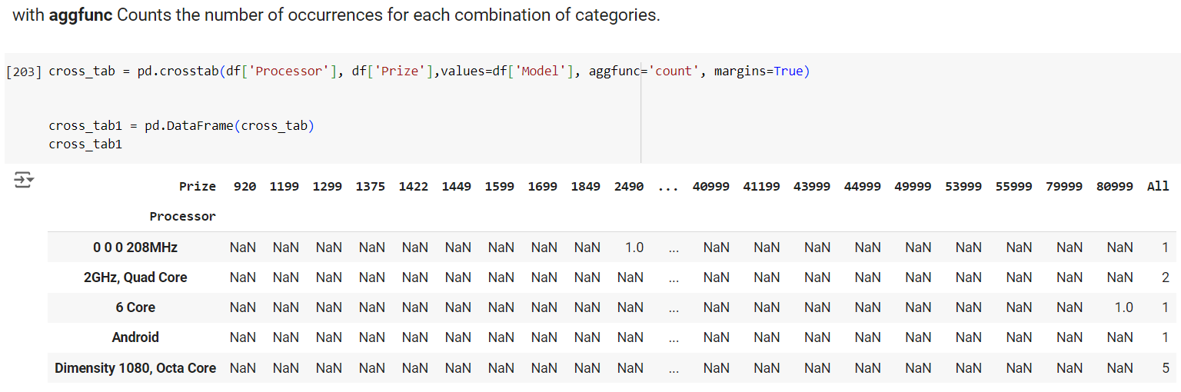
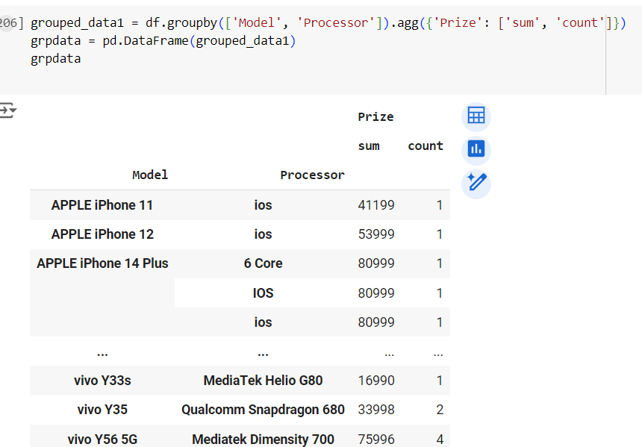
Crosstab is used to aggregate data by groups, providing a summary table that displays the frequency distribution of variables.
groupby method l for data analysis, enabling you to segment your data and perform operations such as sum, mean, count, etc.,

Slide 6
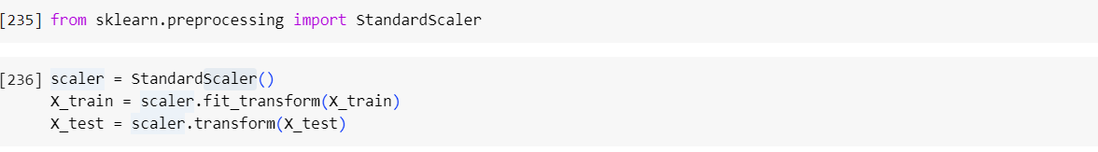
Define the train and the test data
Classifier Model Building:
from sklearn.model_selection import train_test_split
X_train, X_test, y_train, y_test = train_test_split(X,y, test_size = 0.2)
Scaling the Data

Slide 7
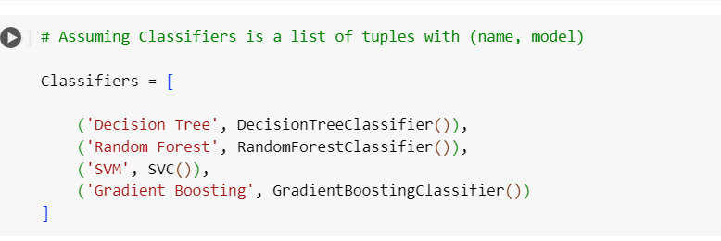
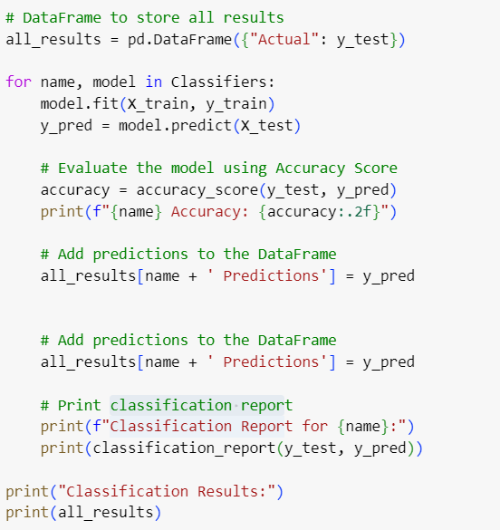
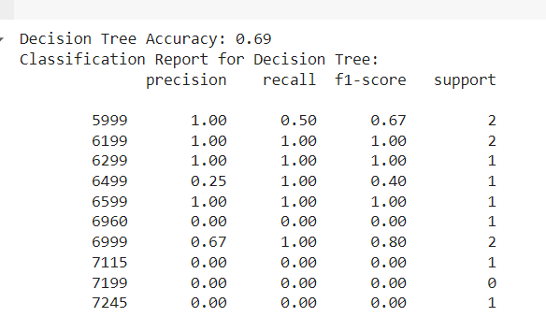
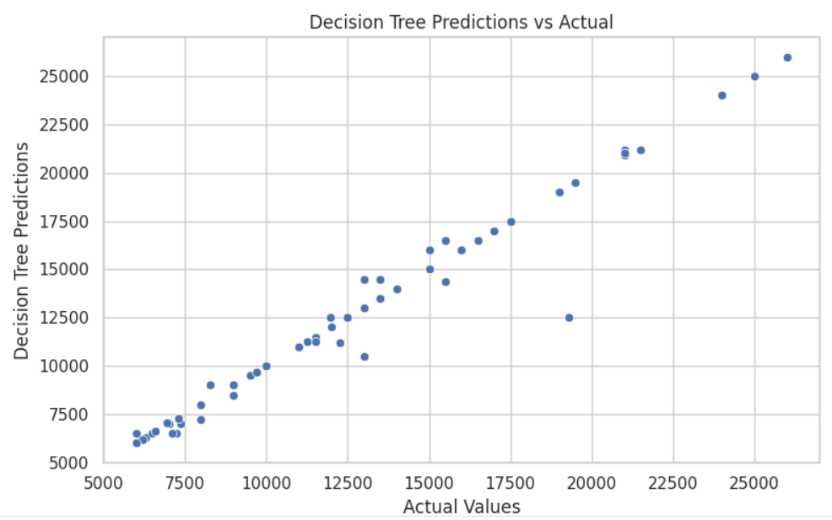
Model Building:
Evaluate the model using Accuracy Score
Add predictions
classification report
plotting

Slide 8
Comments on classifiers Model
Decision Tree Accuracy: 0.69
Random Forest Accuracy: 0.64
SVM Accuracy: 0.22
Gradient Boosting Accuracy: 0.63
Model Performance: The Decision Tree classifier performed the best in terms of accuracy (0.69), followed by Random Forest (0.64) and Gradient Boosting (0.63). SVM had the lowest accuracy (0.22), indicating it struggled significantly with this particular dataset.
Visualization: Decision Trees and Random Forests showed clear, though sometimes irregular, boundaries. SVM likely showed poor separation due to the low accuracy.
Ensemble methods like Random Forest and Gradient Boosting showed reasonably good performance

Slide 9

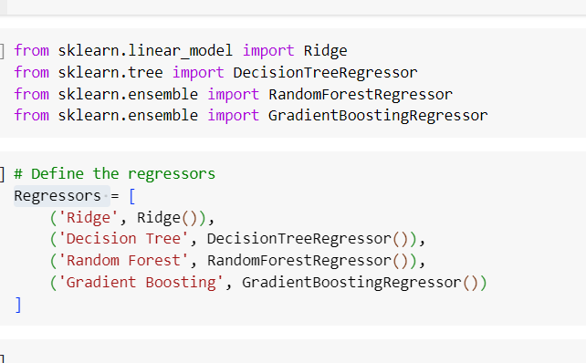
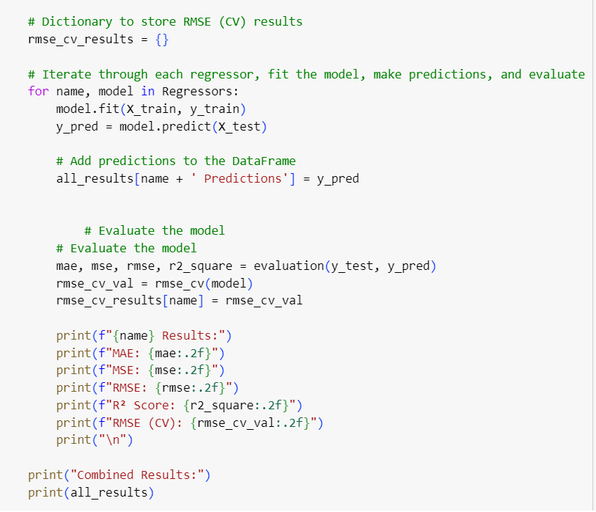
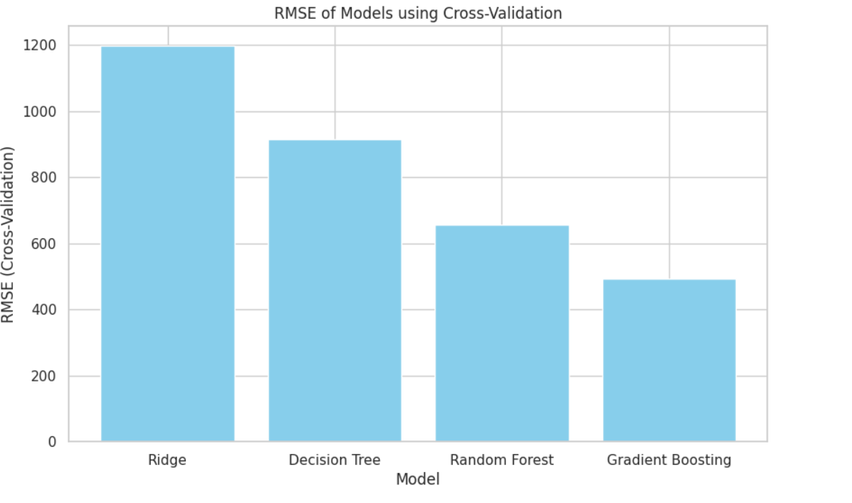
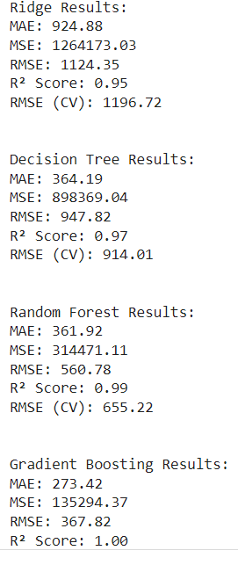
Regressors Model Building:
Evaluate the model using Accuracy Score
Add predictions
classification report
plotting

Slide 10
Comments on Regressors Model
Analysis:
Gradient Boosting Regressor is the best model based on the evaluation metrics and cross-validation RMSE. It has the lowest RMSE (CV) and RMSE on the test set, indicating excellent performance and generalization.
Random Forest Regressor is also a strong candidate, with a significantly lower RMSE (CV) compared to Ridge and Decision Tree but slightly higher than Gradient Boosting.
Therefore, the Gradient Boosting Regressor should be chosen as the final model for this dataset.
Visualization:
The provided bar plot visually supports this conclusion by showing that Gradient Boosting has the lowest RMSE (CV), followed by Random Forest, Ridge, and Decision Tree.
Model​ | MAE | MSE​ | R2 Score​
Ridge | 924.88 | 1264173.03​ | 0.95
Decision Tree | 364.19​ | 898369.04​ | 0.97​
Random Forest | 361.92 | 314471.11​ | 0.99​
Gradient Boosting | 273.42 | 135294.37 | 1.00​

Slide 11
recommendations
Most influential features in pricing
RAM
Storage
Battery life
Camera quality
Ensure that budget models have sufficient RAM and storage for basic use. Focus on essential features such as good battery life and decent camera quality.
Focus on essential features such as good battery life and decent camera quality.
Offer balanced specifications such as decent RAM, adequate storage, and good battery life.
Highlight high RAM, large storage capacities, and advanced processor types.
Utilize the brand reputation and exclusivity to justify higher prices.

Slide 12
THANK YOU

